Slide 1
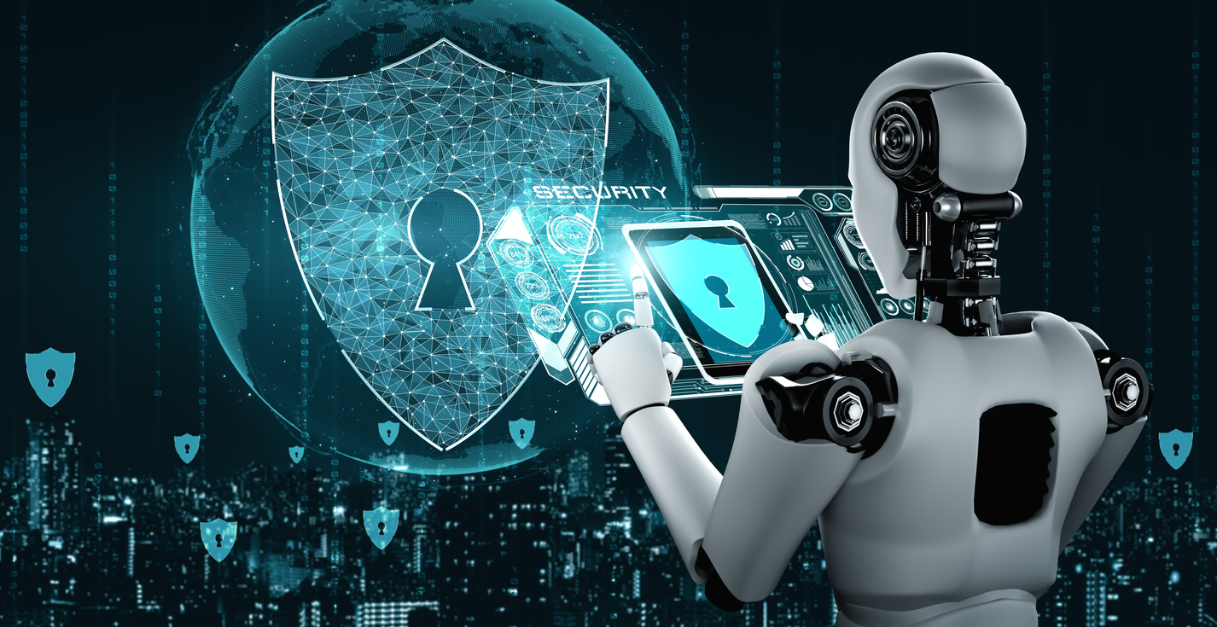
AI in Information Security
Friend or Foe?
Dr Omran Salem
Assistant Professor of Cyber Security – Alzaytoona University – ISO27001 Lead Auditor

Slide 2
Agenda
Why do we need Information Security
What is AI ?
The Friend: How AI Enhances Security
The Foe: Risks and Challenges
Case Studies: Examples of AI in Action
Finding the Balance: Strategies for Mitigation
Questions & Discussion

Slide 3
Why do we need Information Security
Protect against wide range of Cyber Threats
Protection of Sensitive Data
Legal and Regulatory Compliance
Business Continuity and Reputation Management
Emergence of New Technologies

Slide 4
The Friend: How AI Enhances Security
Advanced threat detection
Real-time monitoring and response
Automation of routine tasks
Adaptive security measures
Predictive analytics
Behavioral analysis
Scalability and efficiency
Enhanced Endpoint Security

Slide 5
The Enemy: Risks and Challenges
Vulnerabilities in AI Systems
Adversarial Attacks (tiny changes to current malware)
Overreliance on AI (full dependency on AI systems)
Bias and Ethical Concerns (source of Big data)
Privacy Concerns (data collection of sensitive PI)
Model Poisoning (poisoning training data used to train AI models for IDS systems)
Generative of fake content, news and knowledge
Regulatory and Compliance Risks

Slide 6


Real Case ………. Deepfake

Slide 7
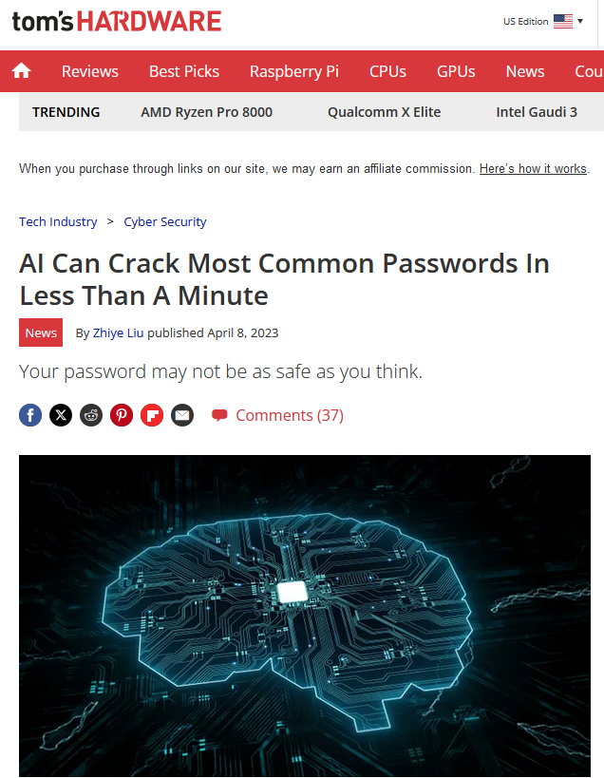
Real Case ………. Deepfake

Slide 8
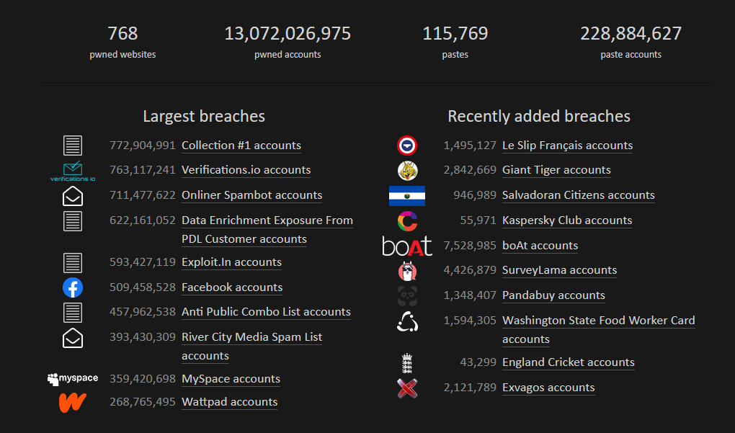
Resources of AI … is the Breached Data… emails and passwords

Slide 9
Finding the Balance: Strategies for Mitigation
Human Oversight and Expertise
Continuous Monitoring and Evaluation
Transparency and Accountability
Ethical Frameworks and Guidelines
Data Governance and Privacy Protection
Collaboration and Information Sharing
Risk Assessment and Mitigation
Training and Education
Regulatory Compliance
Adaptive Security Strategies

Slide 10
Questions & Discussion

