Slide 1

AI Platforms
By:
Ali M. Hajjaj
Labiba.ai

Slide 2


Slide 3
1,460,912,312 / 273

Slide 4
Computers Don’t Think Like Humans

Slide 5
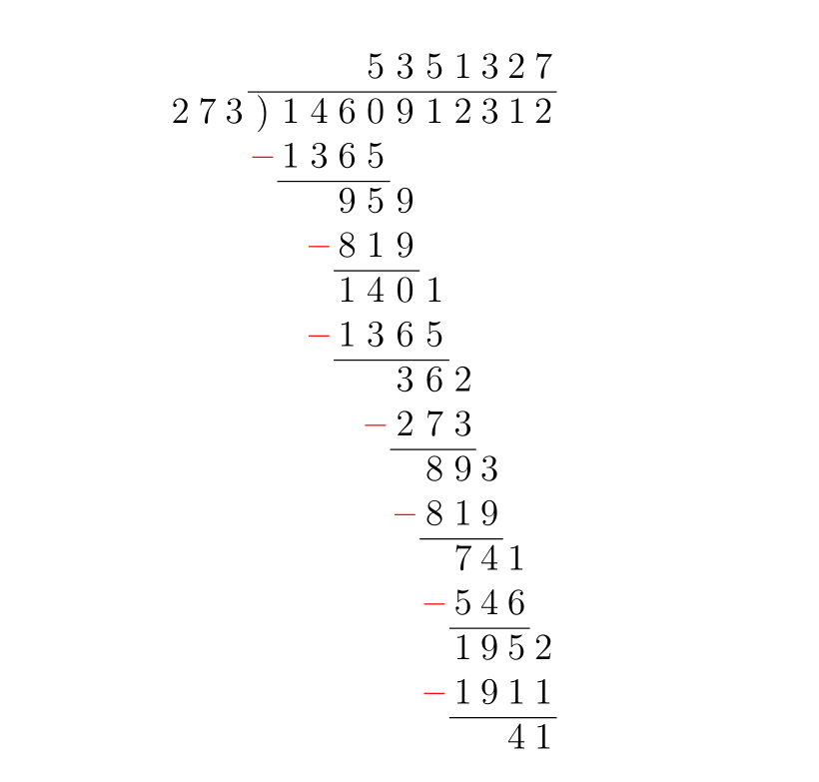

Slide 6

Computers could only solve problems that are addressed as a process

Slide 7
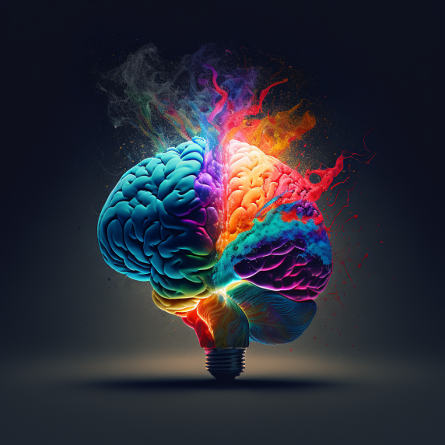
Creativity
Critical Thinking
Decision Making
Language
Poetry
Design

Slide 8

Narrow Intelligence

Slide 9

General Intelligence

Slide 10
Walter Pitts & Warren Mcculloch

Slide 11


Slide 12


Slide 13
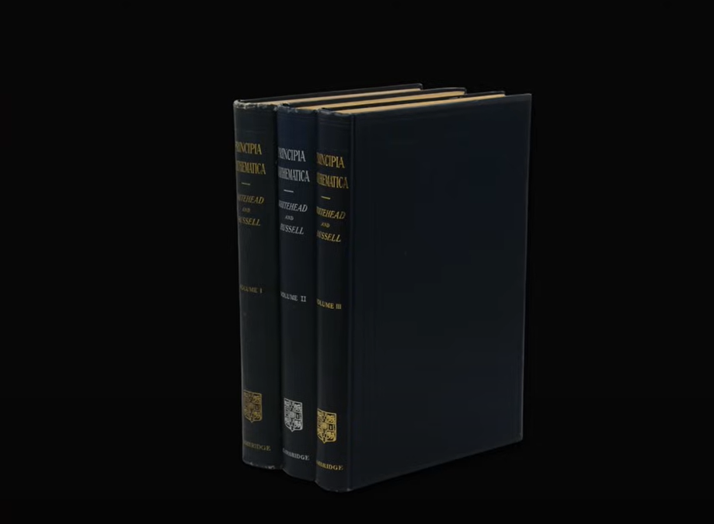
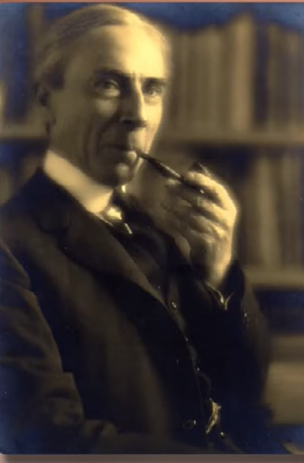
Bertrand Russell
Principia Mathematica

Slide 14
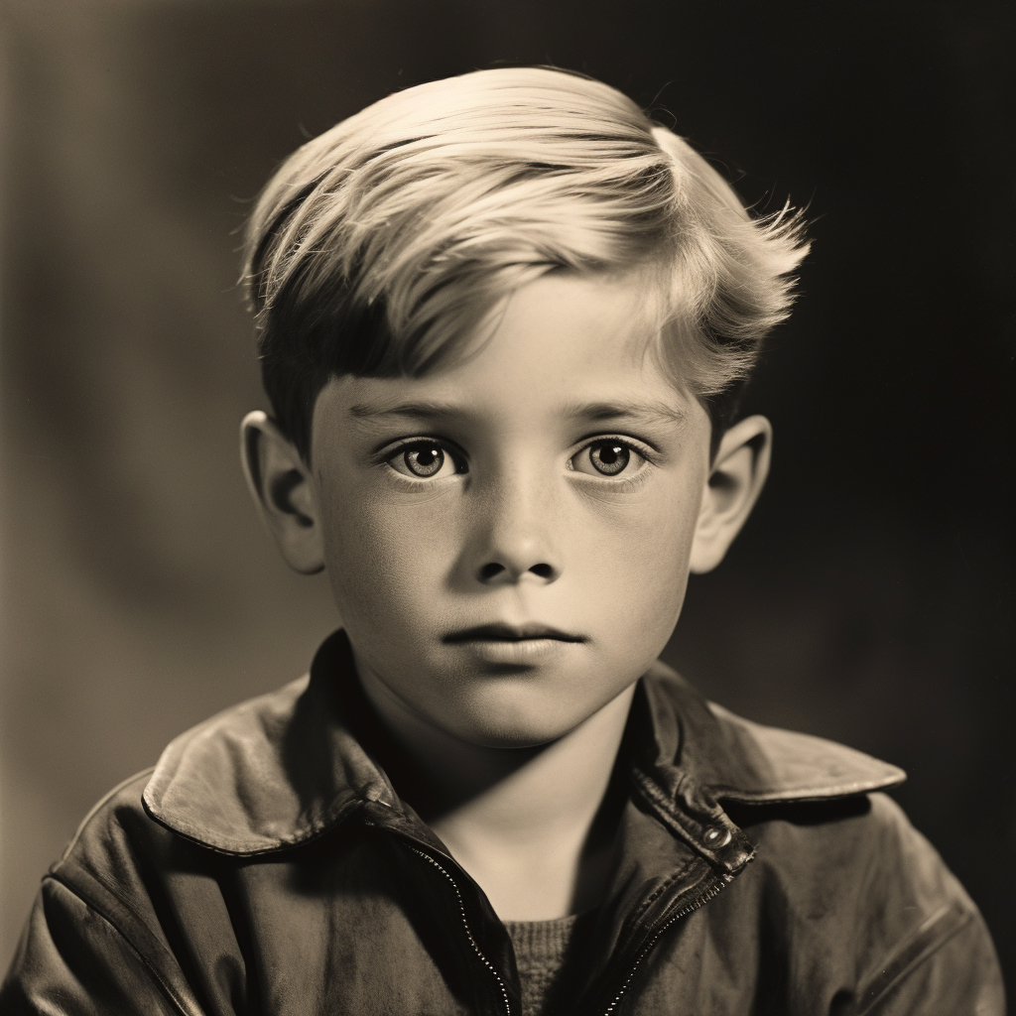
Walter Pitts

Slide 15
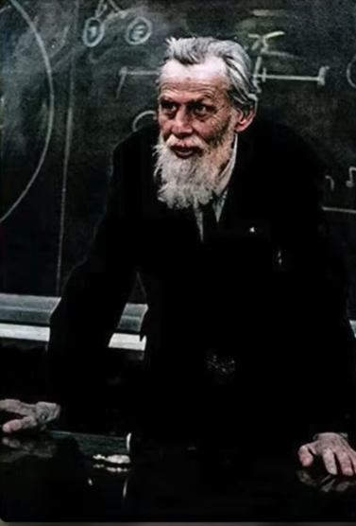
Psychologist
Psychiatrist
Neurophysiologist
Doctor
Neurosurgeon
Philosopher
Teacher
Poet
Engineer
Mathematician
University Professor
Warren Mcculloch

Slide 16
1943 Beginnings
2012
Narrow AI
2022

Slide 17
2023

Slide 18


Slide 19


Slide 20
A Jordanian Mona Lisa

Slide 21
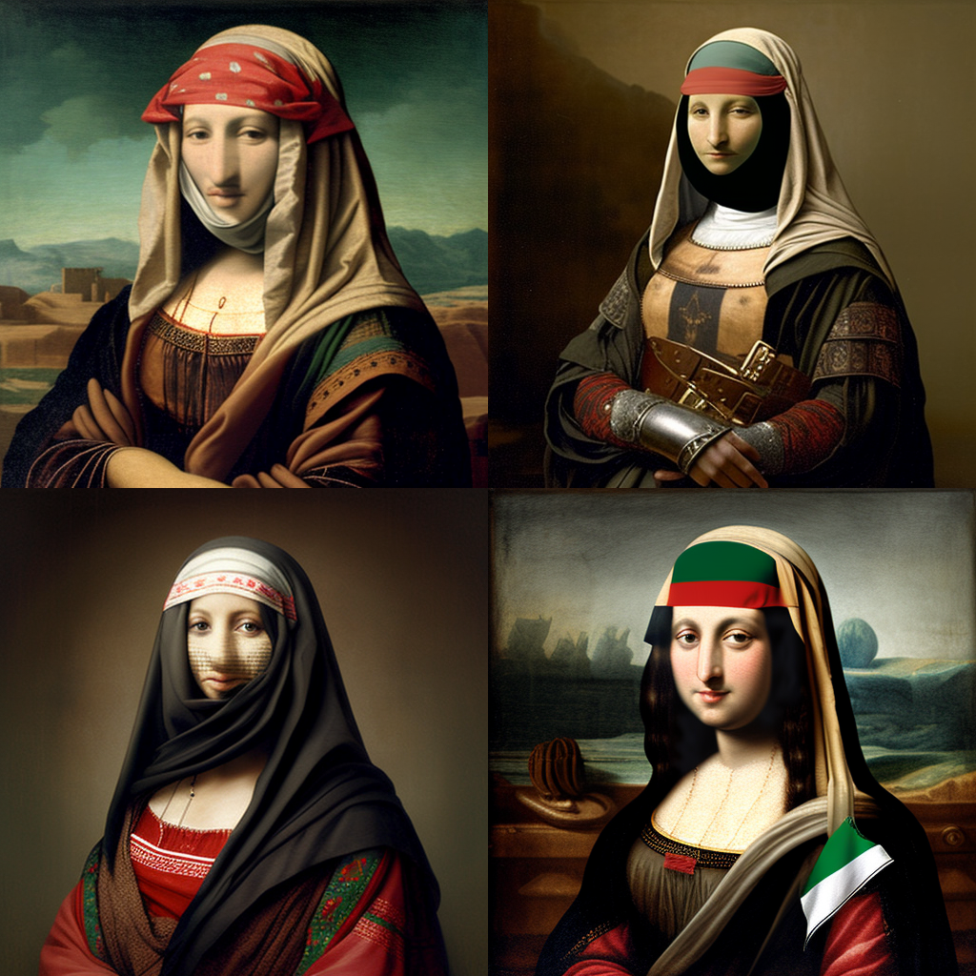

Slide 22
A Painting of Petra following Van Gough Starry Night Style

Slide 23
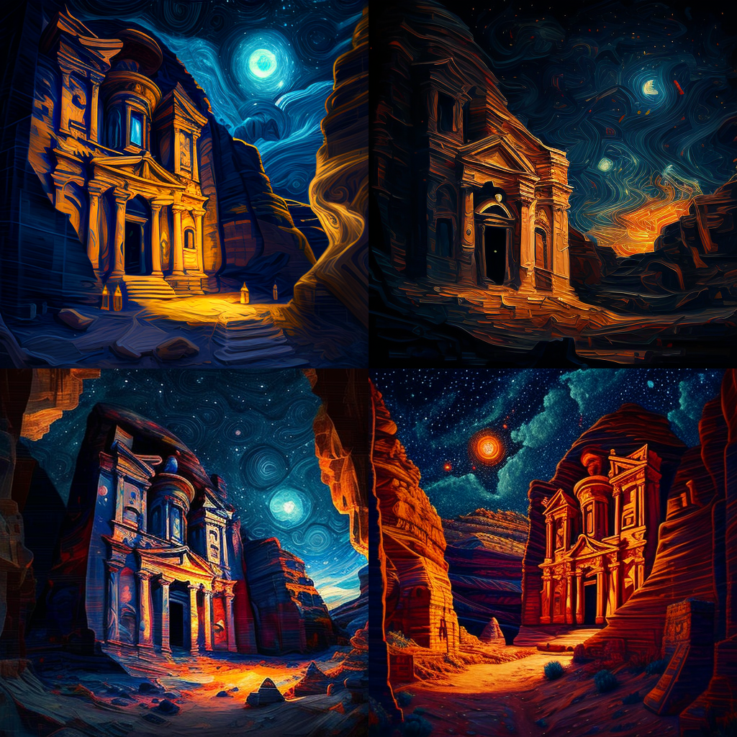

Slide 24


Slide 25
A Landing Page to Sell Nike Shoes

Slide 26
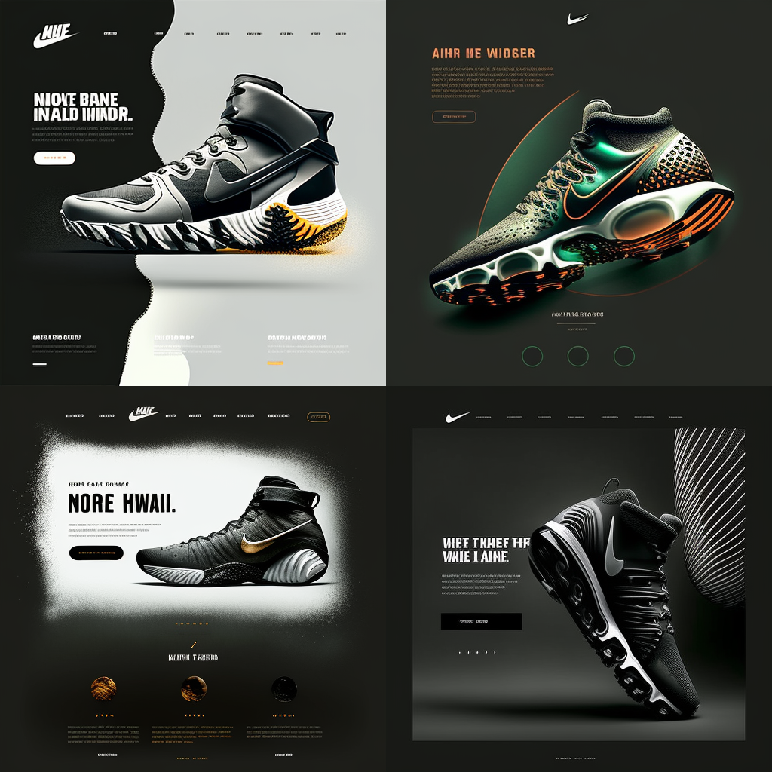

Slide 27
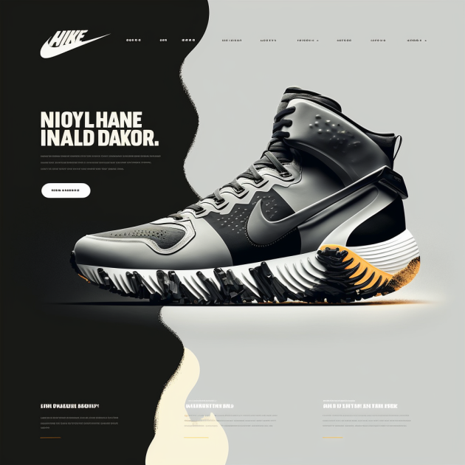

Slide 28
A Man Sitting on his Desk, Smiling & Facing the Camera

Slide 29


Slide 30
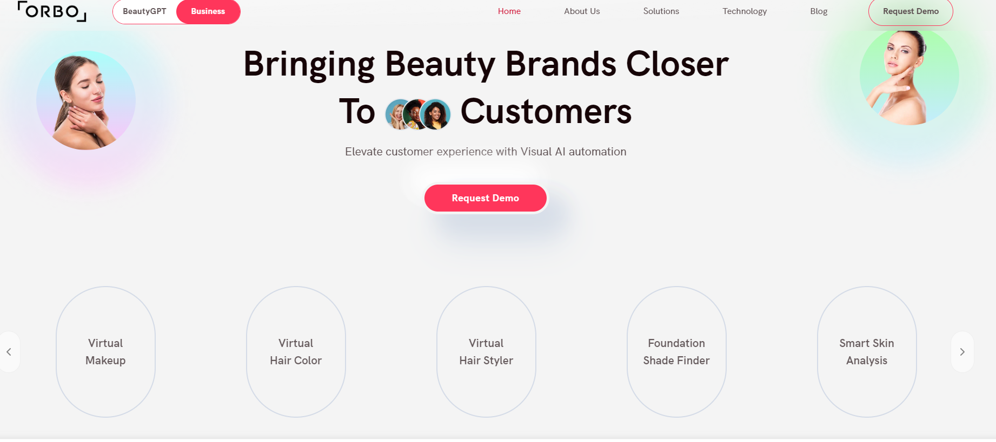

Slide 31
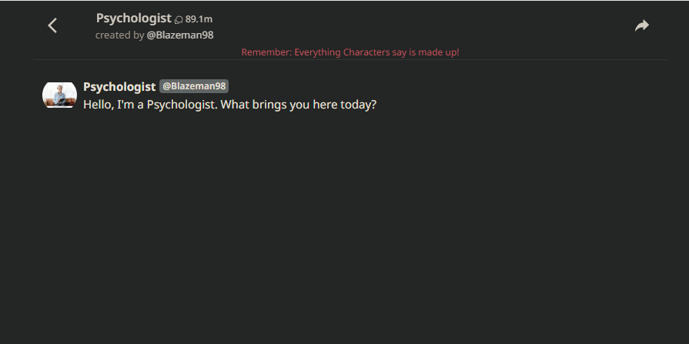

Slide 32
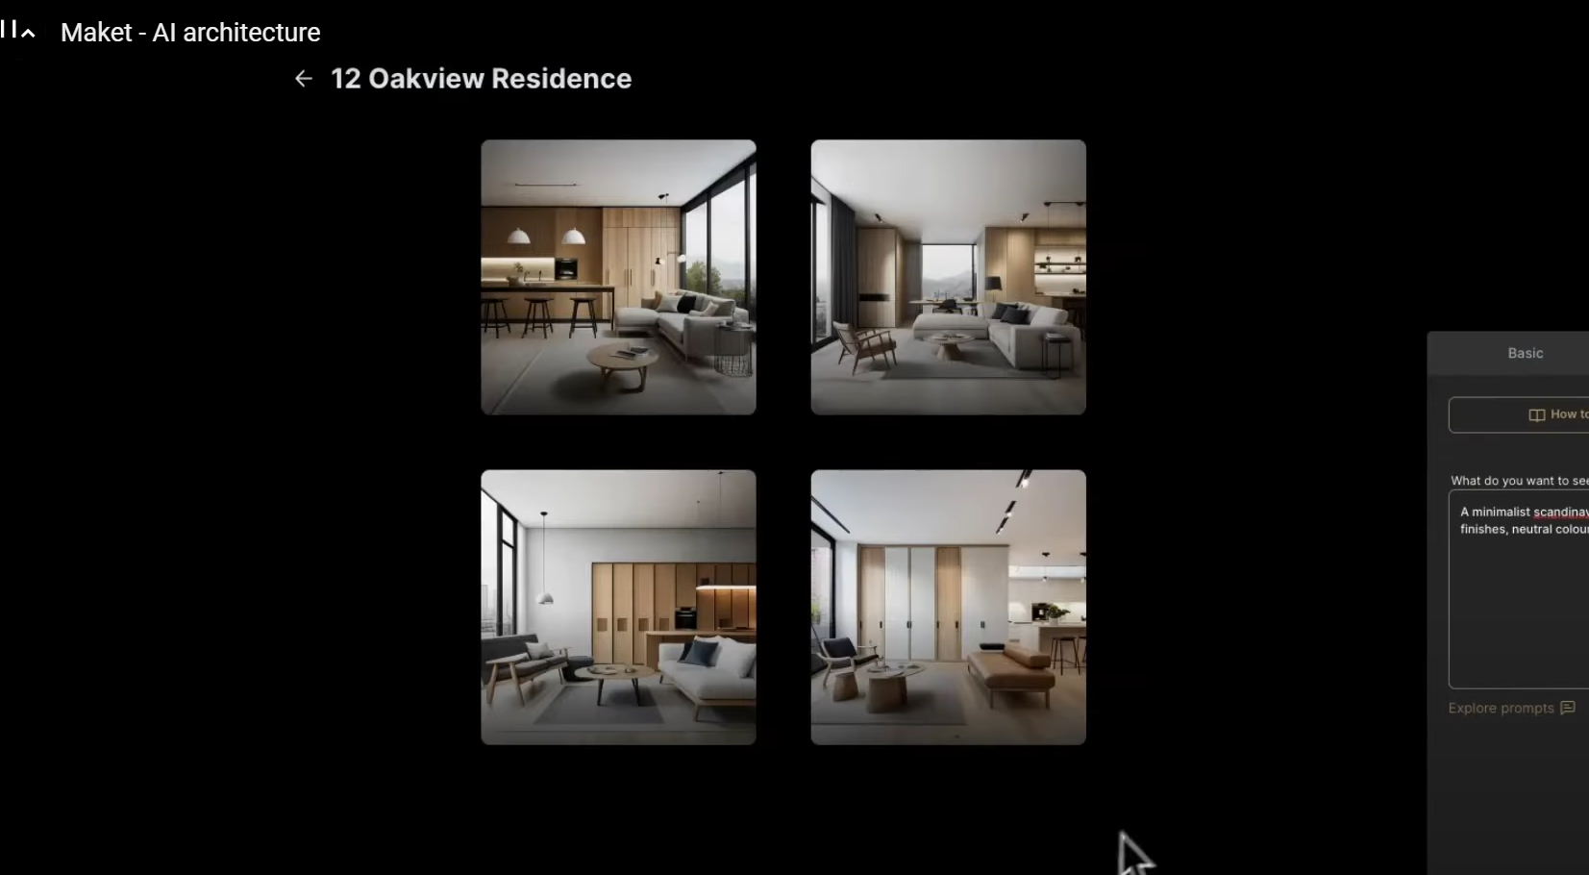

Slide 33
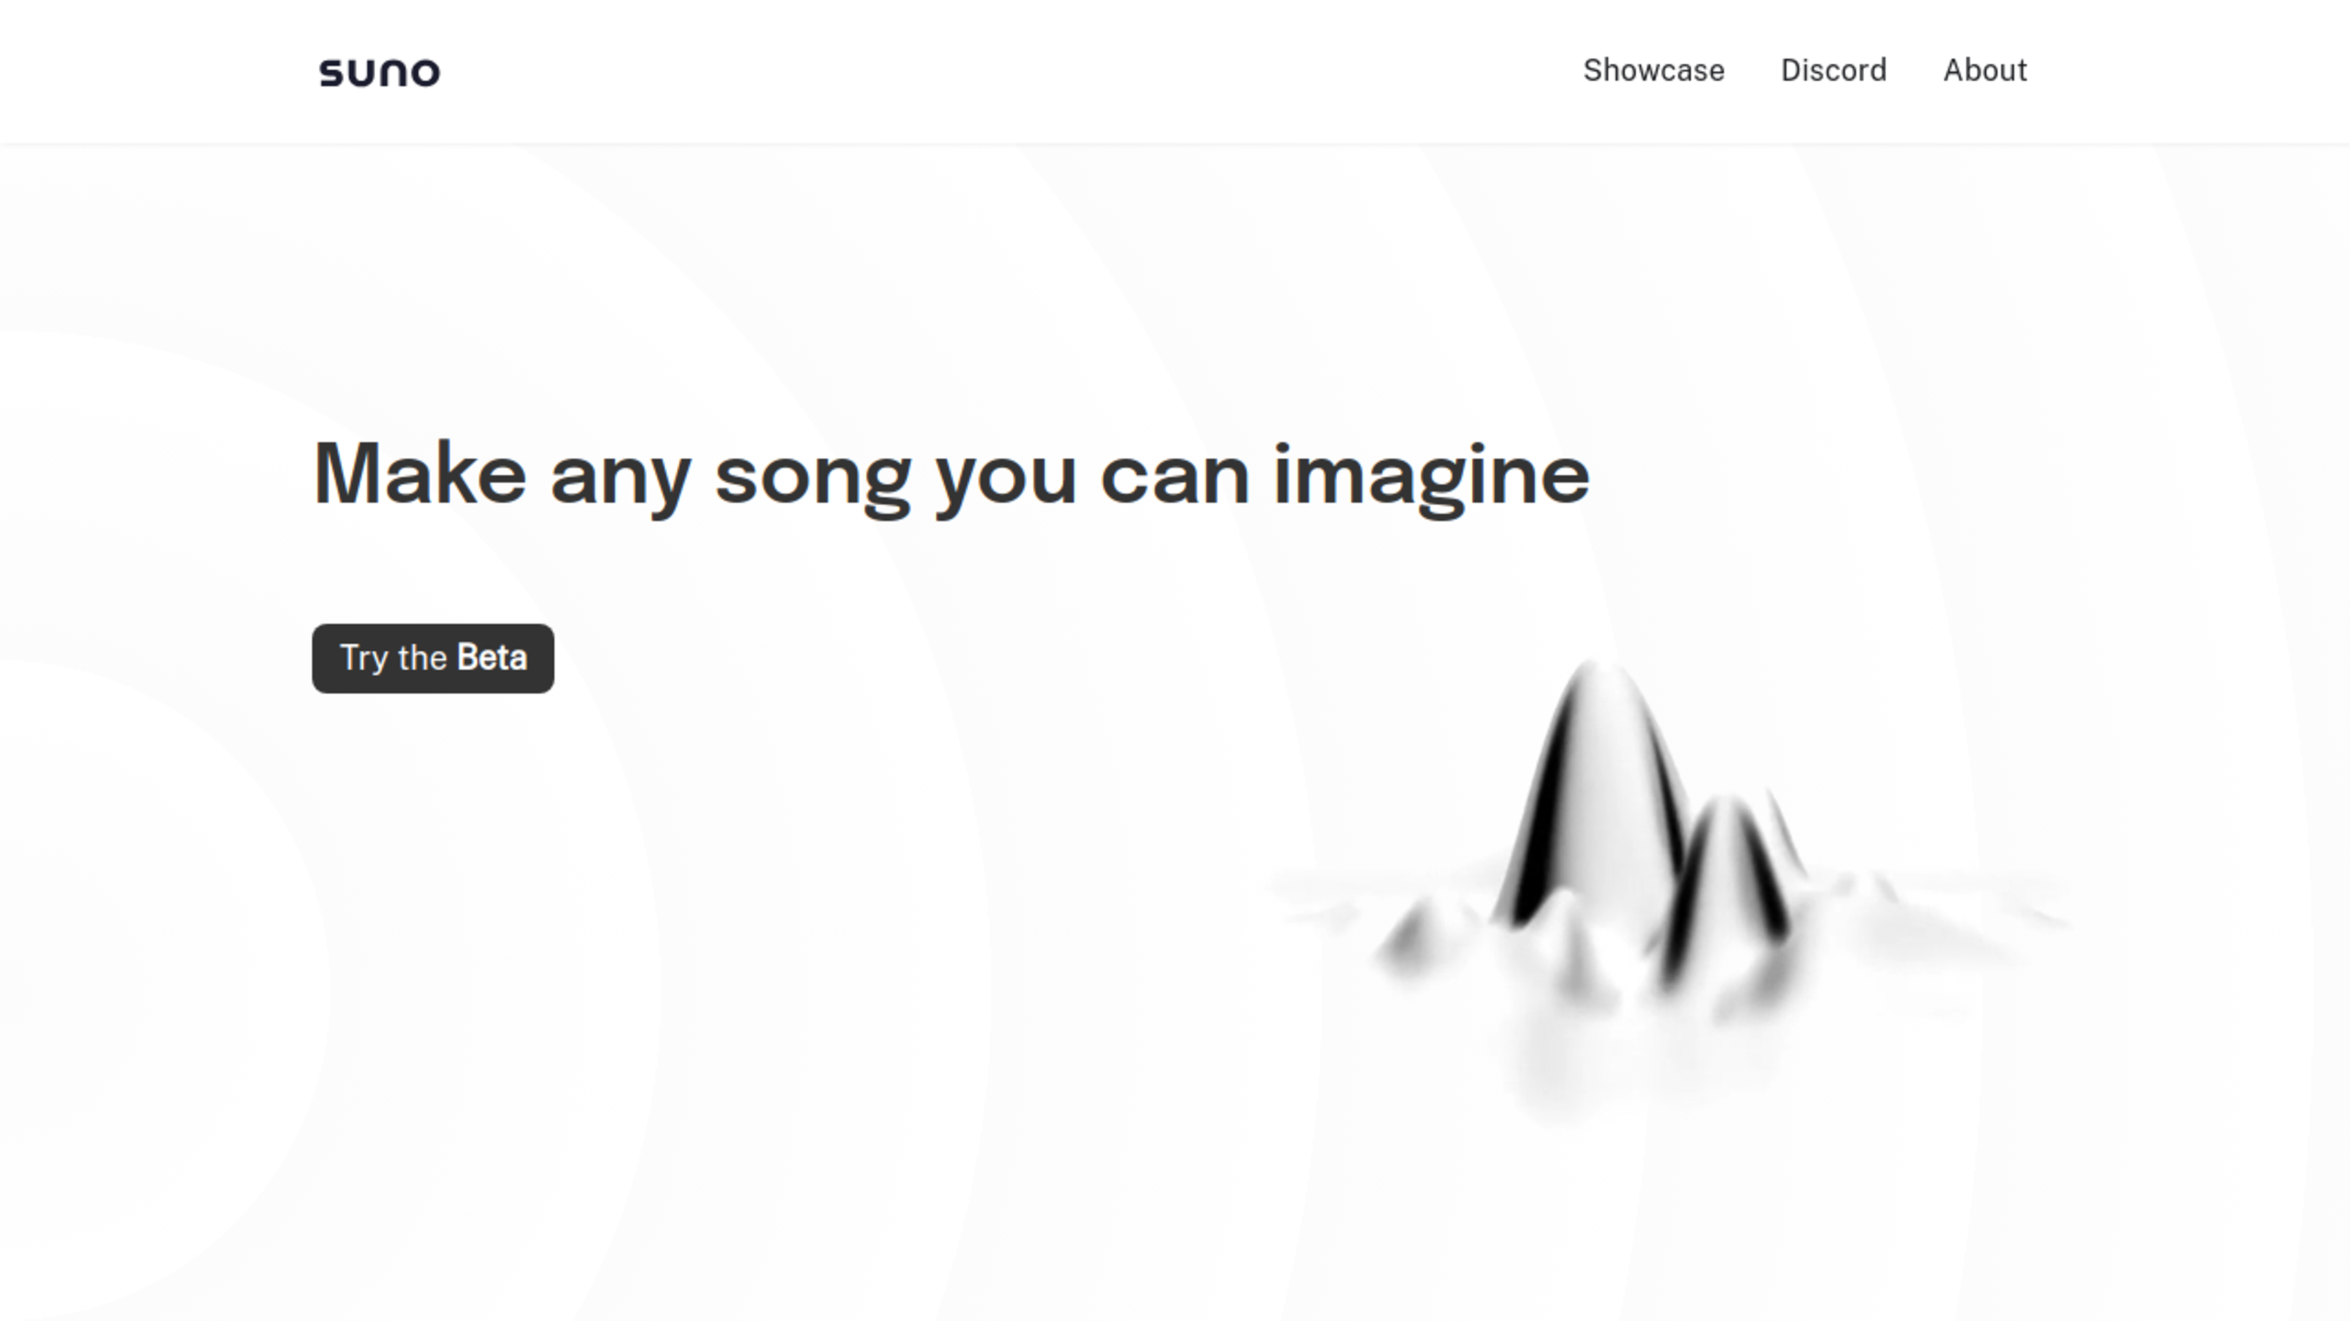

Slide 34
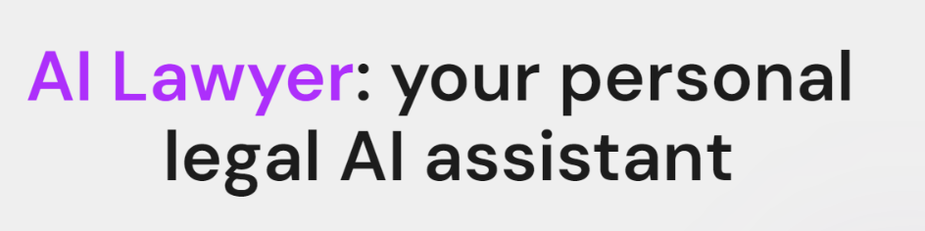

Slide 35


Slide 36
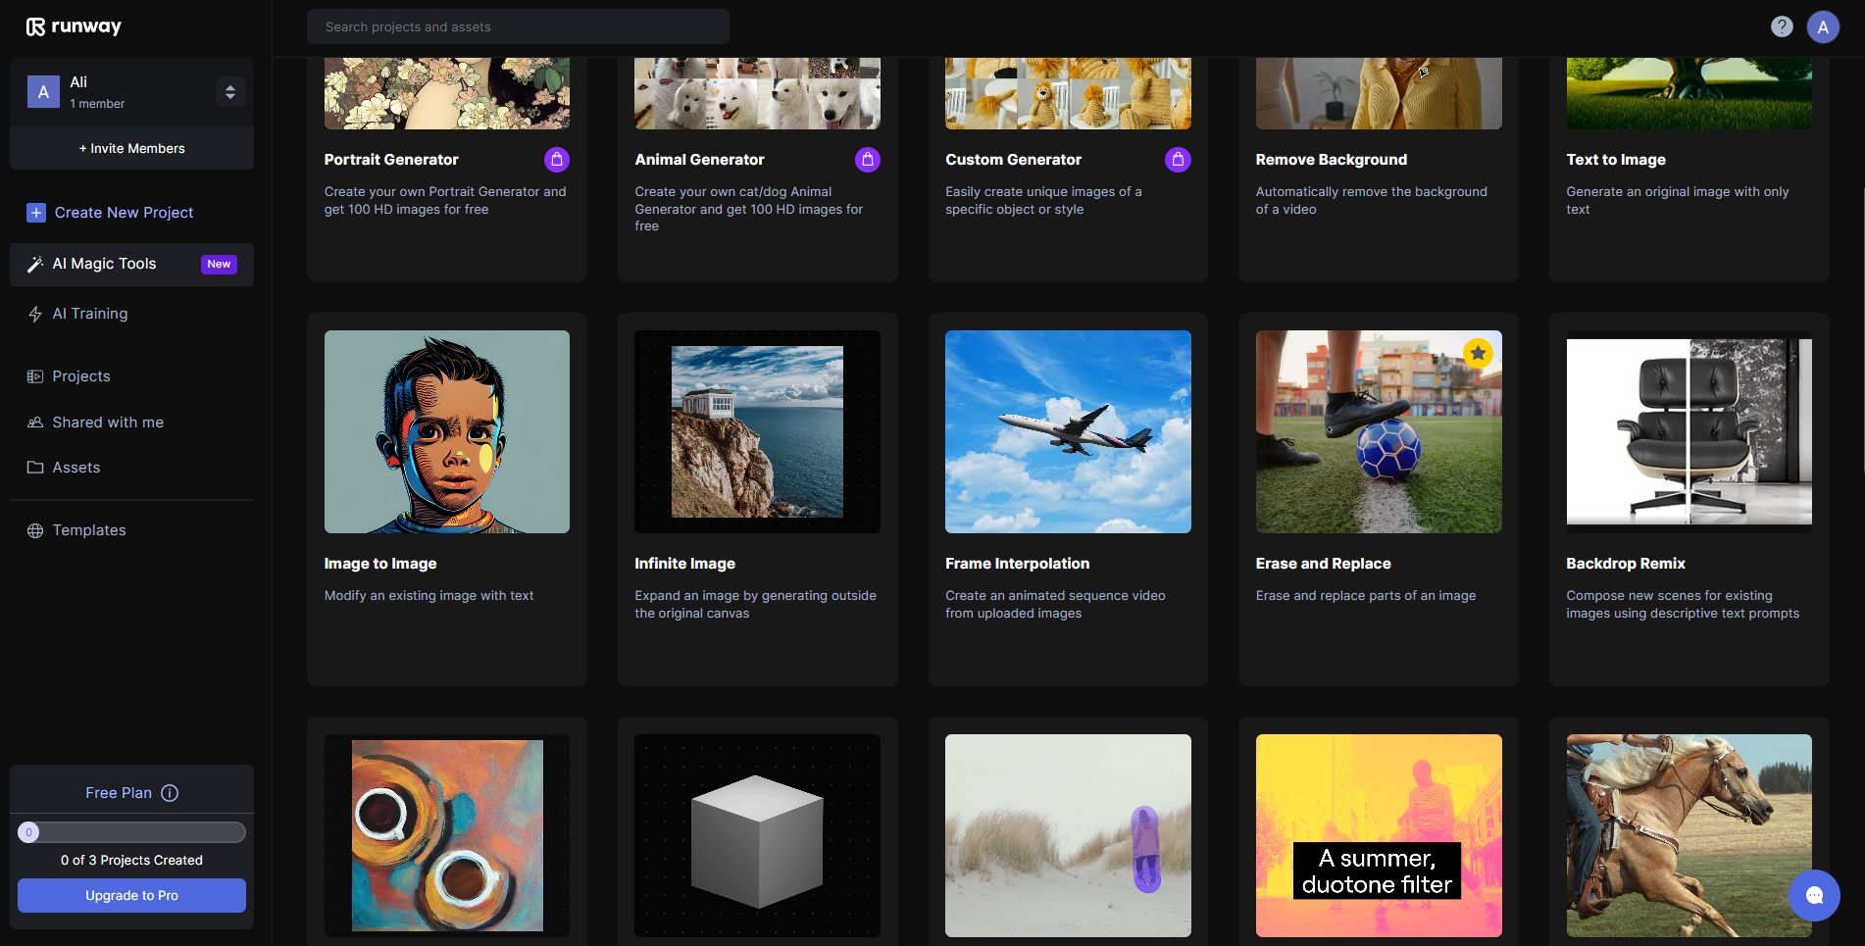

Slide 37

_{AI Capabilities}

Slide 38







Artificial Intelligence for Better User Experience
Cognitive Powers
UNDERSTAND
Understand the natural language of customers and turn it into predefined intents and entities that can be questions to answer or functions to execute
SEE
Allows the bot to recognize items, validate IDs, Passports or process documents or recognize people using biometric data.
HEAR
Understand spoken language, recognize people using their voice.
SPEAK
Respond with voice, natural voice with local dialects providing a human-like user experience.
FEEL
Feel the user’s sentiment, positive or negative and drive the proper course of action accordingly.
REASON
Ability to process large amounts of data to identify trends and patterns to recommend the next best offer or action.
REMEMBER
Ability to all previous interactions with customers and use that to converse with relevance

Slide 39


Slide 40
Human
AI
Availability

Slide 41
Human
AI
Availability

Slide 42
Human
AI
Availability
Time with Patient

Slide 43
Human
AI
Availability
Time with Patient

Slide 44
Human
AI
Availability
Time with Patient
Patient Medical History

Slide 45
Human
AI
Availability
Time with Patient
Patient Medical History

Slide 46
Human
AI
Availability
Time with Patient
Patient Medical History
Diagnostic Against all Possible Diseases

Slide 47
Human
AI
Availability
Time with Patient
Patient Medical History
Diagnostic Against all Possible Diseases

Slide 48
Human
AI
Availability
Time with Patient
Patient Medical History
Diagnostic Against all Possible Diseases
Knowledge of Recent Research & Publication

Slide 49
Human
AI
Availability
Time with Patient
Patient Medical History
Diagnostic Against all Possible Diseases
Knowledge of Recent Research & Publication

Slide 50
_{Building A Virtual Teacher}

Slide 51
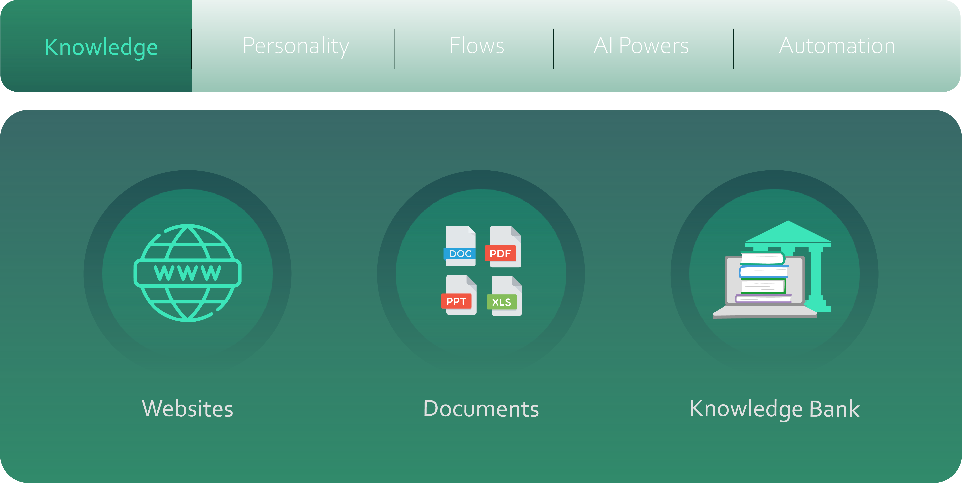

Create a Virtual Teacher

Slide 52
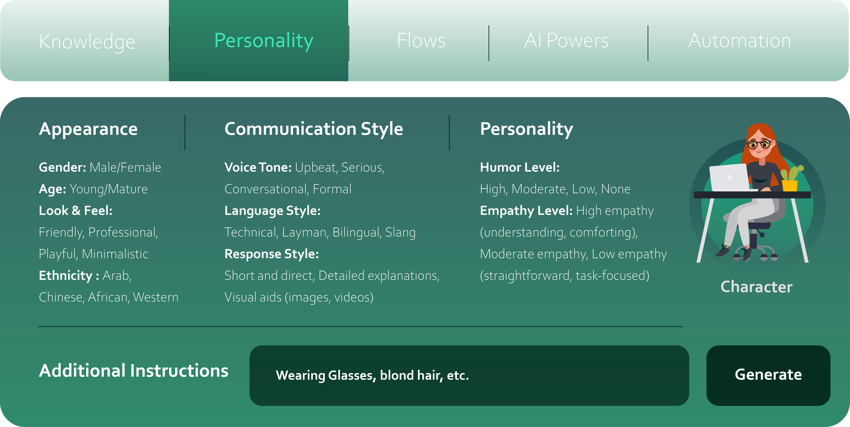
Create a Virtual Teacher

Slide 53
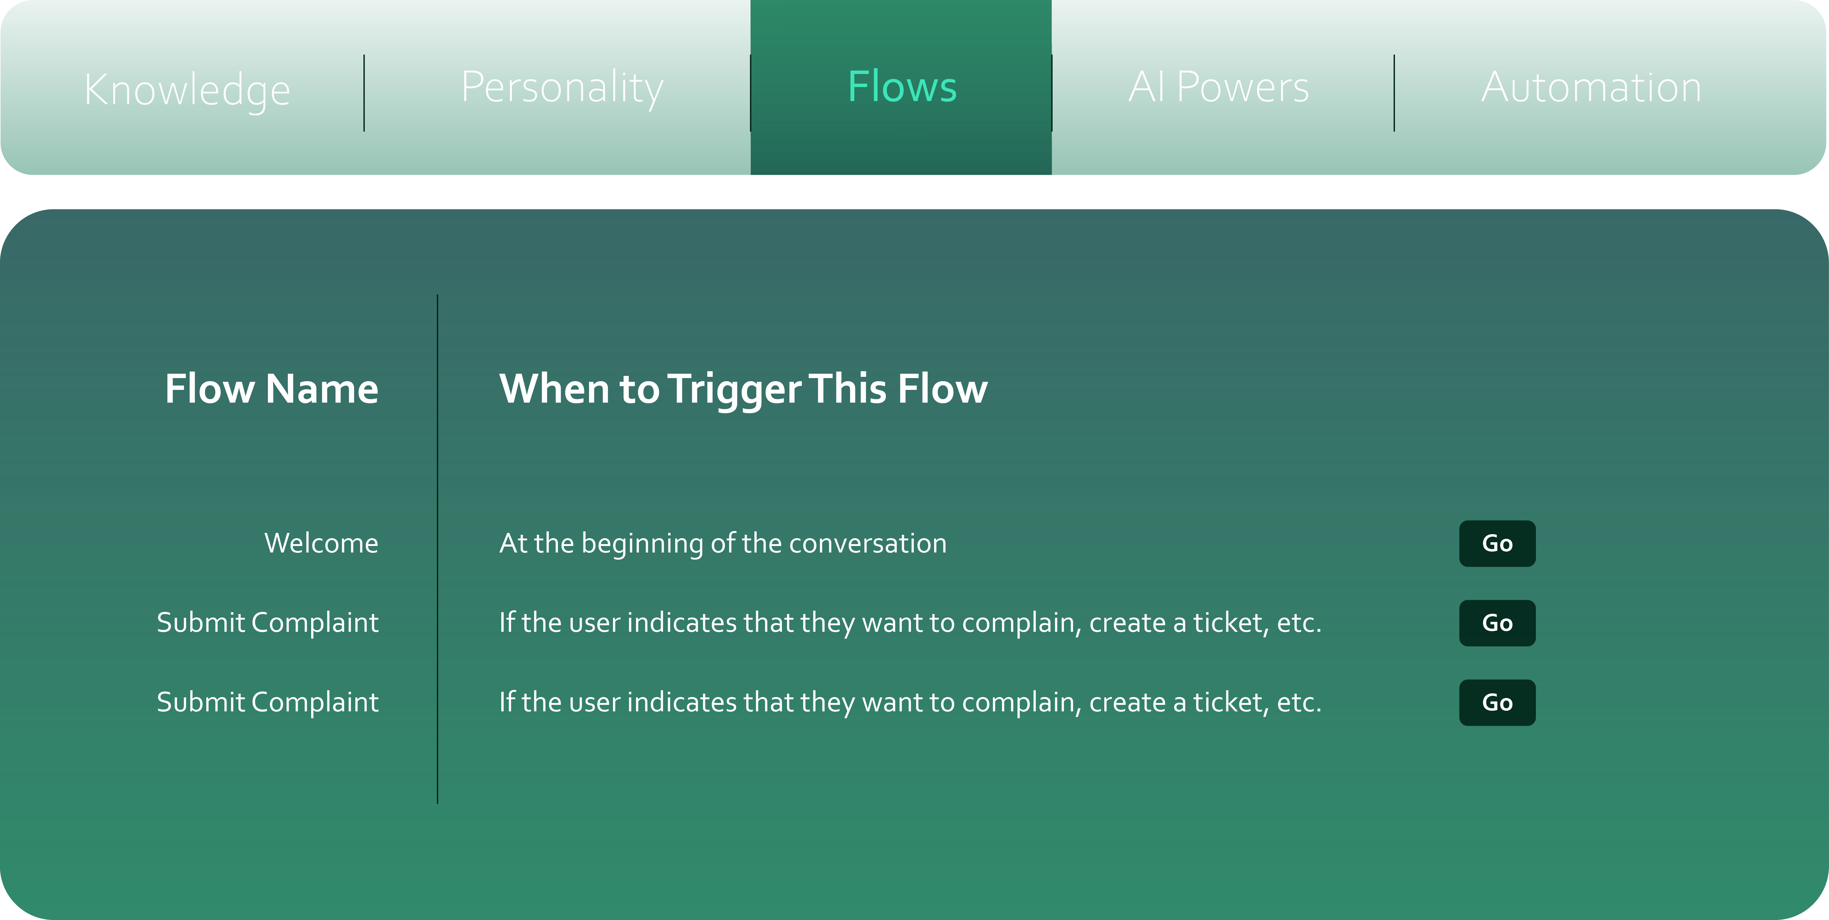

Create a Virtual Teacher

Slide 54
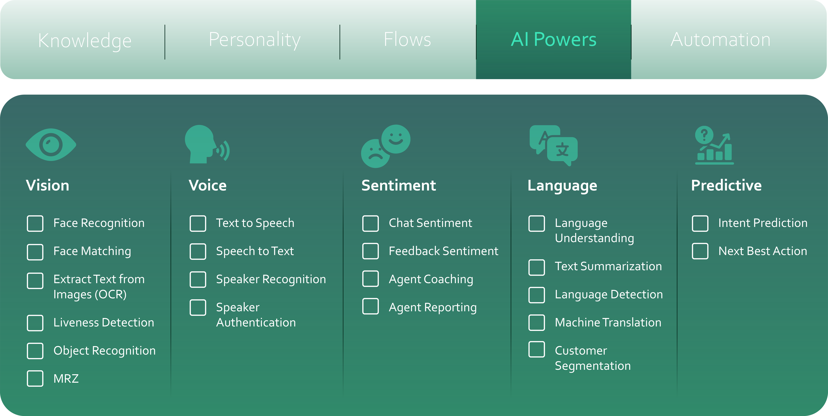
Create a Virtual Teacher

Slide 55
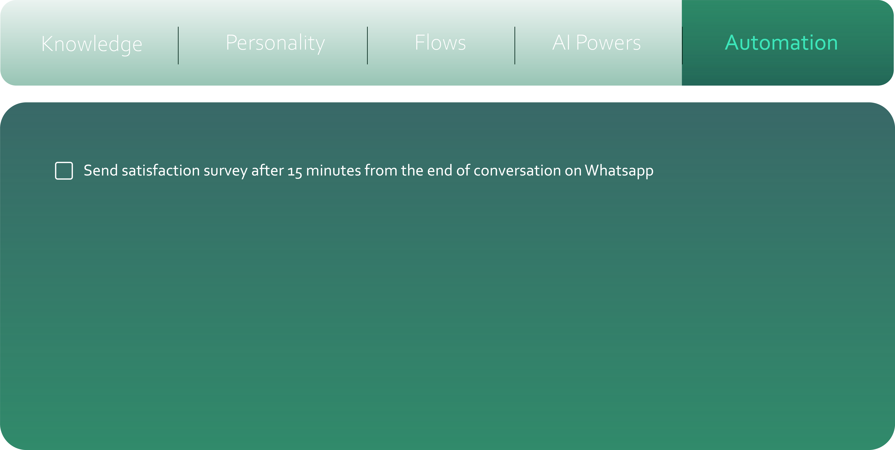
Create a Virtual Teacher

Slide 56
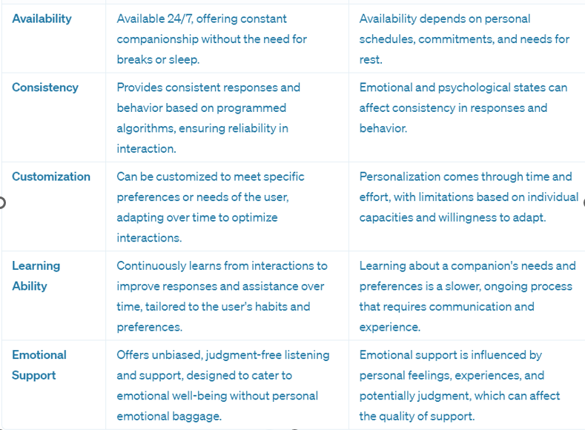

Slide 57
The Alignment Problem

Slide 58


Slide 59


