Slide 1
Metaverse PSUT Experience
By Dr. Adiy Tweissi

Slide 2
E-learning in General

Slide 3
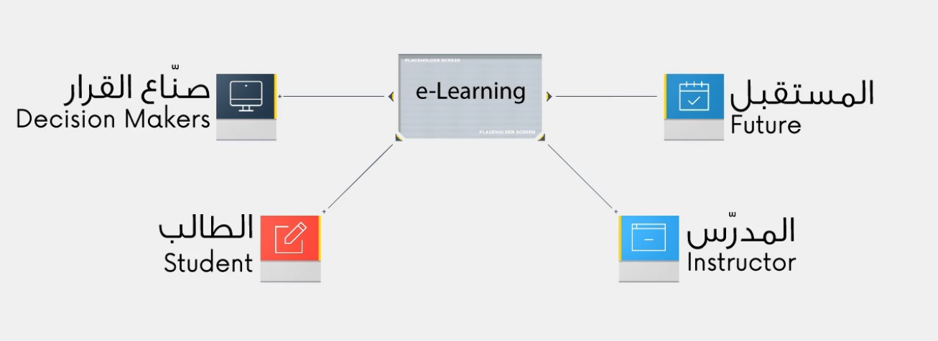

Slide 4

Learning Management Systems (LMS)
المساقات الرقمية المفتوحة MOOCs
يتم إدارتها وصناعة محتواها من خلال نظم إدارة التعليم الرقمية LMS

Slide 5
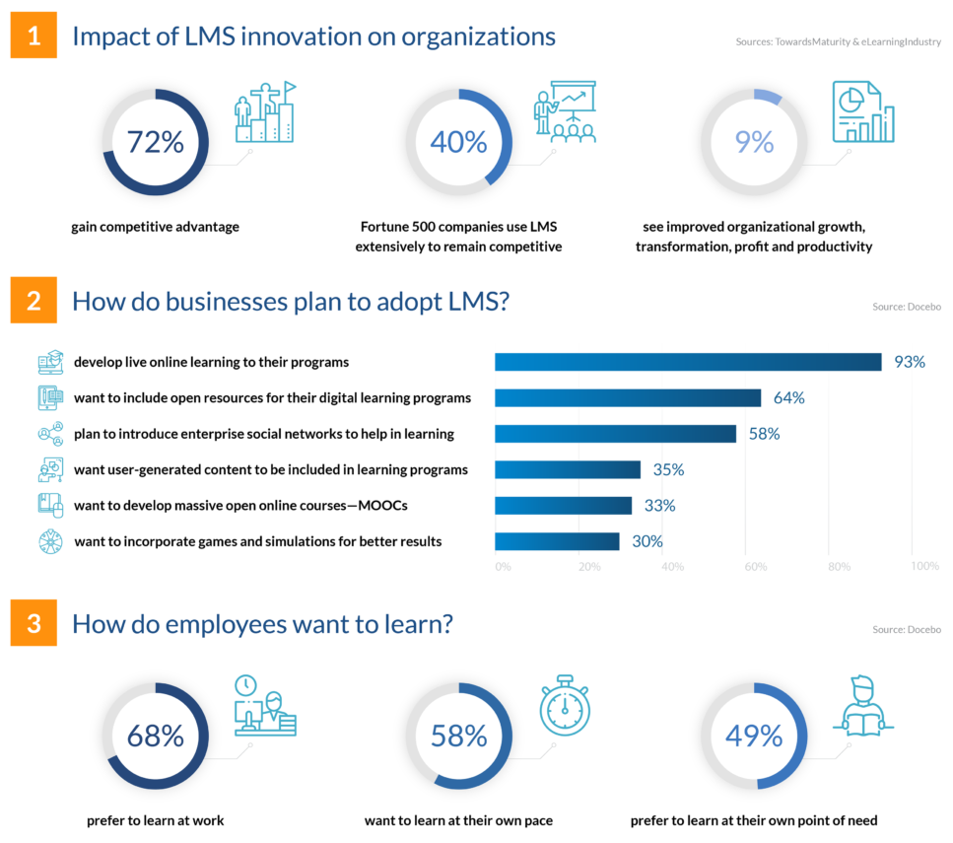
Three important things to know about LMS

Slide 6

Current Teaching Methods
التعلم على شبكة الإنترنت كلياً
Fully Online Learning
التعلم المباشر Face-to-Face
التعلم المدمج Blended Learning
التعلم الهجين Hybrid Learning

Slide 7
Emerging Technologies Metaverse Case

Slide 8
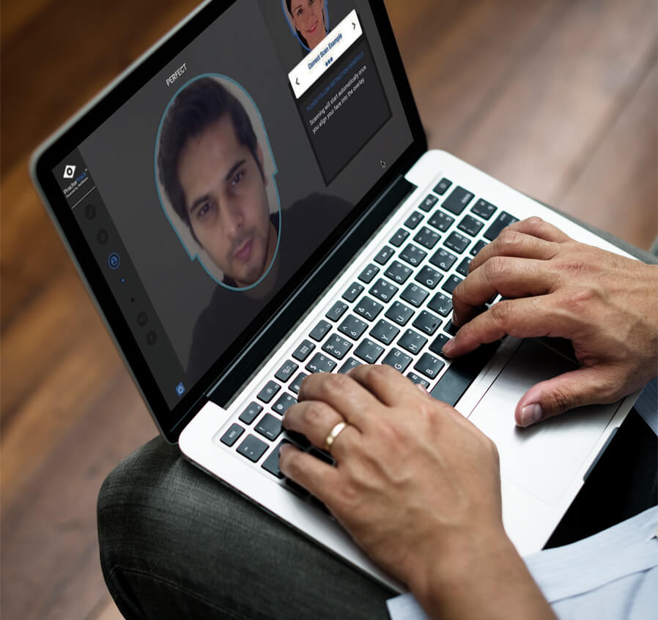
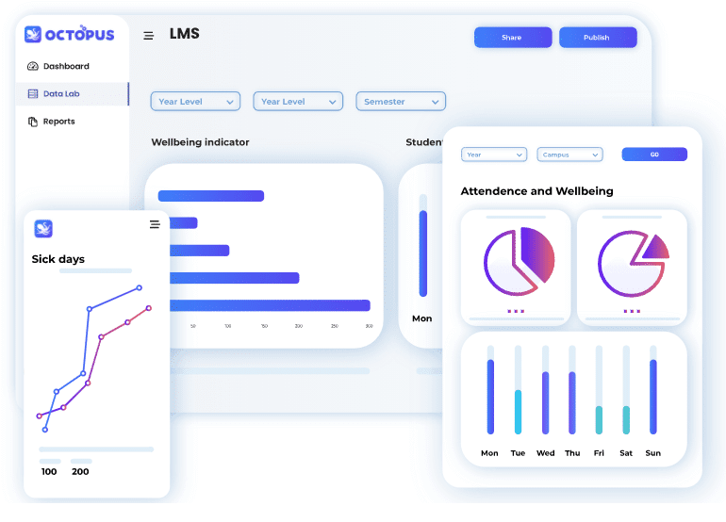

Slide 9
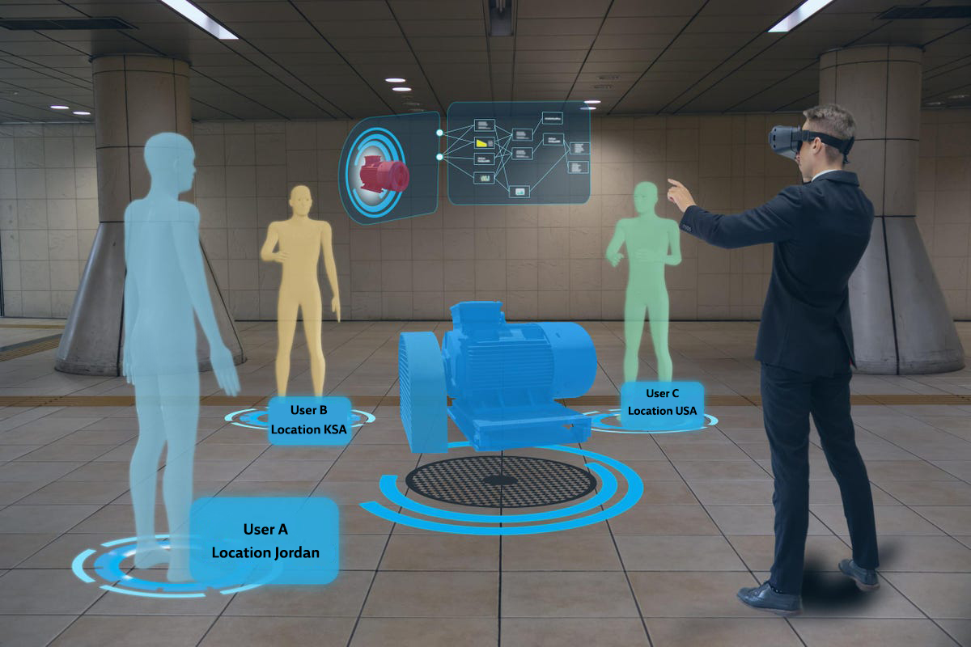
What is the Metaverse?

Slide 10
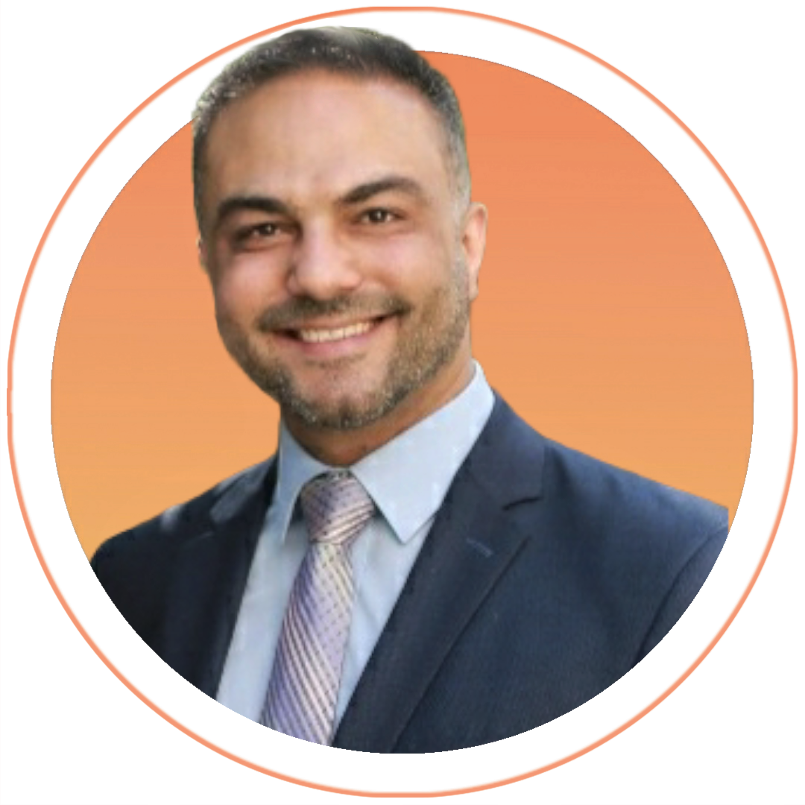
Holds a PhD in Instructional Design and Technology, Ohio University - USA
Master's degree in Computer Science, Western Michigan University Bachelor's degree in Computer Engineering.
B.Sc. In Computer Engineering from the University of Jordan.
He has more than 10 years of experience in development, execution, evaluation, and management of collaborative programs for a number of universities around the world.
Dr. Tweissi's research focuses on:
Online education development in the MENA region, Artificial Intelligence integration with e-Learning,
Computer Networking, and Technology Futurism.
Dr. Adiy Tweissi – Director of eLearning Centre, Assistant Professor in King Talal School of Business Technology

Slide 11
Thank You

